Slide 1



SHOPFORHOME
CAPSTONE PROJECT

Slide 2

SUBMITTED BY
SHOPFORHOME – A SHOP AT YOUR HOME
LEARNING PARTNER – GREAT LEARNING
COMPANY –WIPRO LIMITED
BATCH C-2
GROUP NO G-25
MENTOR NAME – MS DIMPLE GULATI
1. Kuraku Nageswara
2. Barli Sushma
3. Sai Aditya Potnuru
4. Mohd Wali
5. Bada Sai Kalyan

Slide 3

TABLE OF CONTENTS
ABSTACT
INTRODUCTION
REQUIREMENTS
DATABASE SCHEMA
APPLICATION
SCREENSHOTS

Slide 4
ABSTRACT
This is a website that allows people to buy and sell physical goods over the internet rather than at a brick-and-mortar location. It is useful in the way as it makes an easier way to buy and sell goods online. ShopForHome is an interactive e-commerce solution providing users with an opportunity to purchase and sell things.
In this website we have basically 2 modules. The first module includes the user module and second module includes admin module. The customer have to register for any enquiry related to goods. The registered customer can view details of goods and he/she can purchase the items of his/her need. He/she has to pay and will get home delivery. The admin module contains the access of admin page on the website. The admin can change everything in the website. He have the ability to add, delete, and update any information regarding the goods.

Slide 5
INTRODUCTION
Ecommerce has changed the way people shop and consume products and services. More and more people are turning to their computers and smart devices to order goods, which can easily be delivered to their homes.
ShopForHome – Its like a market at your doorstep, you can purchase goods online. You have no need to step out of home that’s why its named shop for home. It is a popular Store in the market for shopping the home decor stuff. Due to pandemic all the offline shopping is deeply affected . So, the store wants to move to the online platforms and wants their own web application.
There are 2 users on the application: -
1.Admin
2.User

Slide 6
Admin Stories –
1.Admin should be able to login, Logout and Register into the application, be able to perform CRUD on Users and products.
2. Admin should be able to Perform CRUD on the products.
3. Admin should be able to get bulk upload option to upload a csv for products details
4. Admin should be able to get the stocks and be able to mail if any stock is less than 10.
5. Admin should be able to get the sales report of a specific duration.
6. Admin should be able to set the discount coupons for the specific set of users.

Slide 7
User Stories –
1.User should be able to login, Logout and Register into the application and able to see the products in different categories.
3.User should be able to sort the products and add the products into the shopping cart.
5.User should be able to increase or decrease the quantity added in the cart, can be “n” number of products.
7.User should be able to get the Wishlist, add those products which don’t want to order now
8.User should get different discount coupons

Slide 8








ESSENTIAL TOOLS AND LANGUAGES
TOOLS-
VISUAL STUDIO CODE
ECLIPSE
MY SQL
POSTMAN
LANGUAGES-
HTML
CSS
JAVA
MySQL

Slide 9
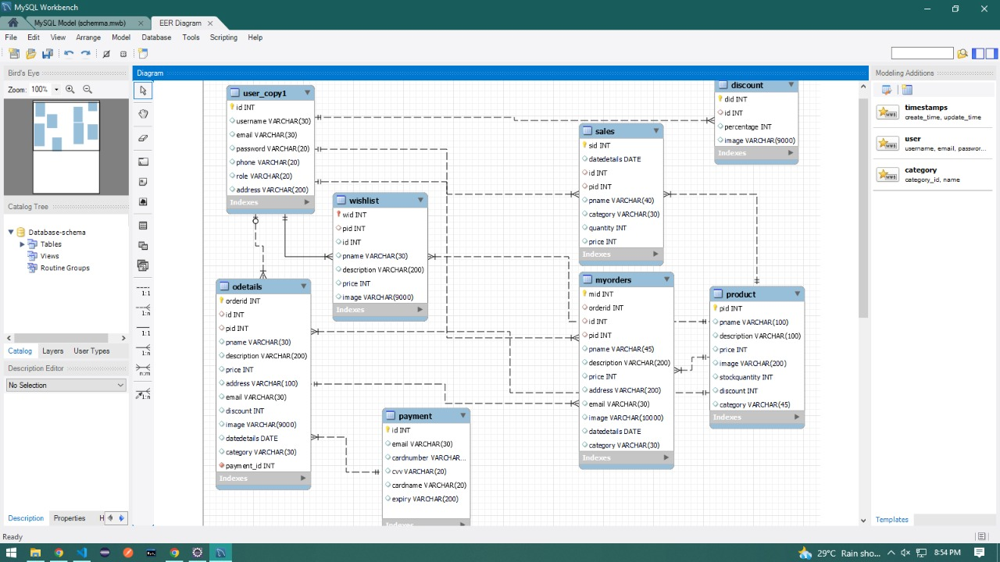
DATABASE SCHEMA

Slide 10
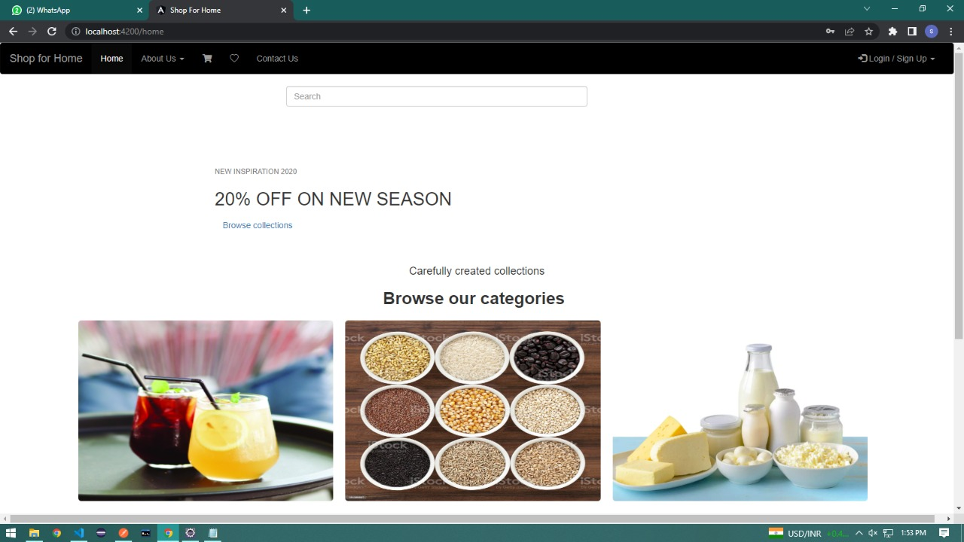
SHOPFORHOME - HOMEPAGE

Slide 11
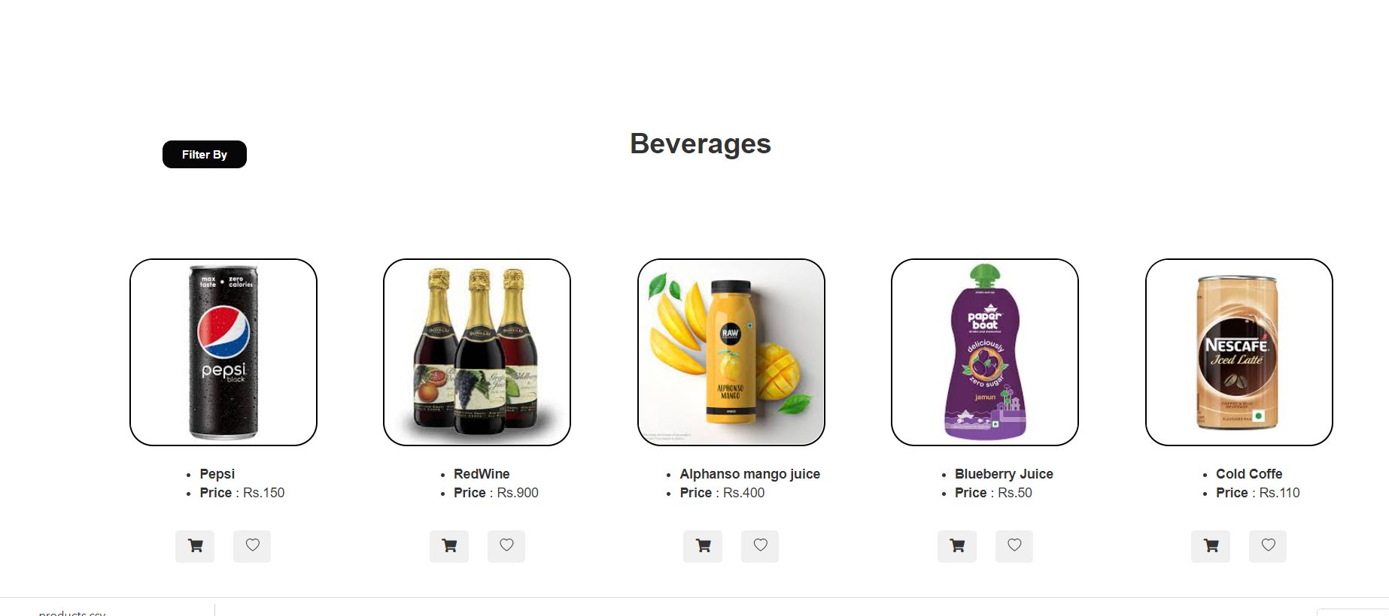
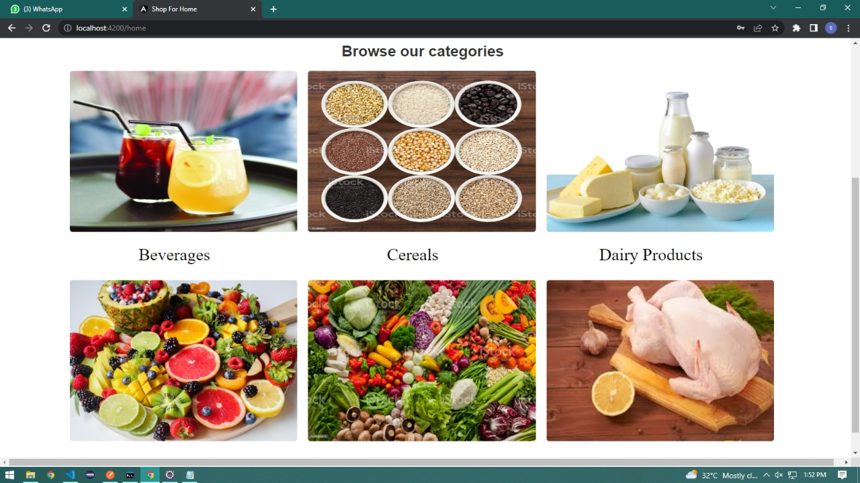
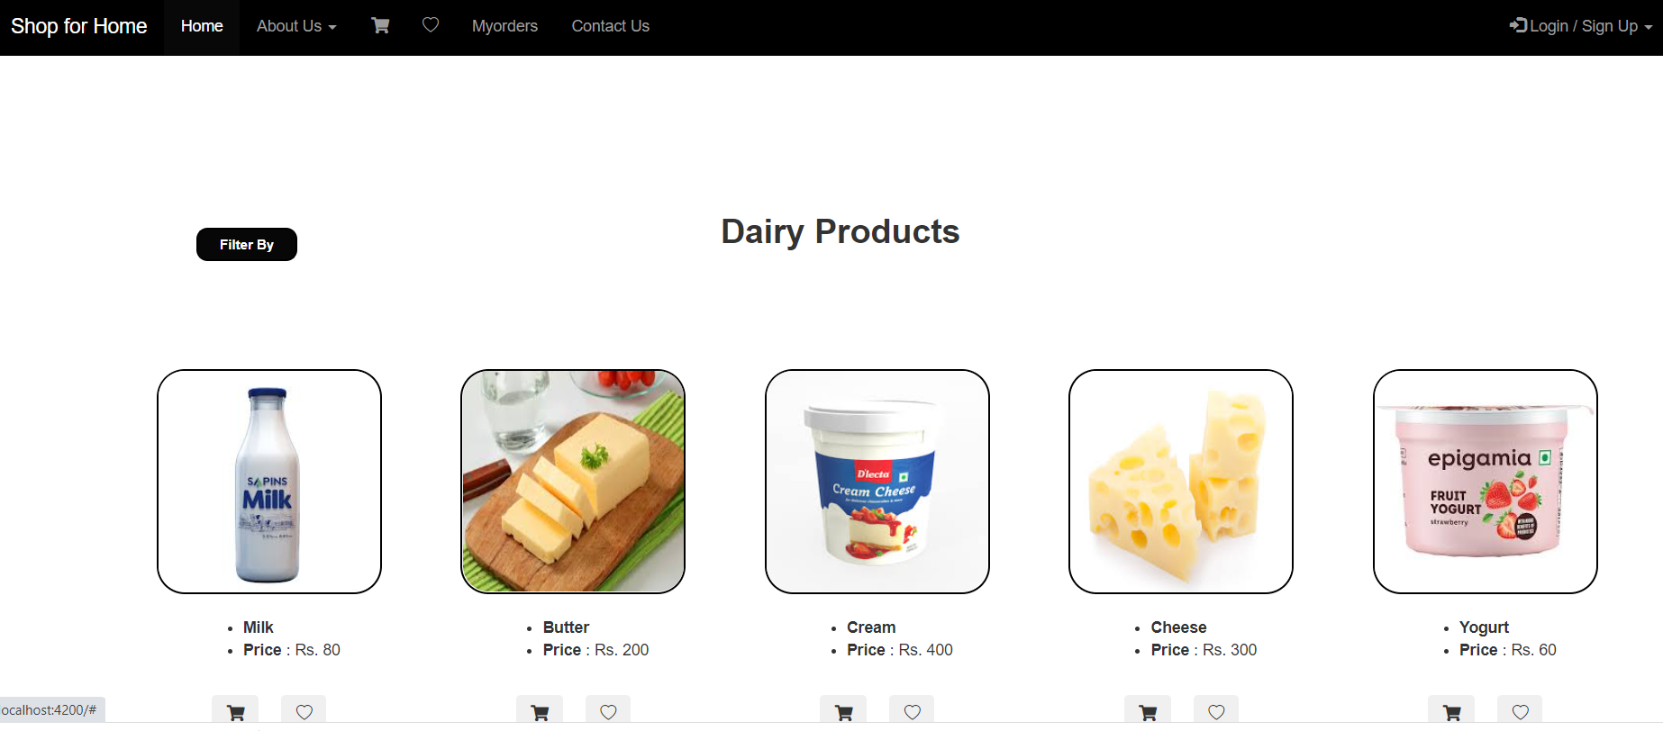
CATEGORIES PAGE

Slide 12


REGISTRATION AND SIGN IN PAGE

Slide 13
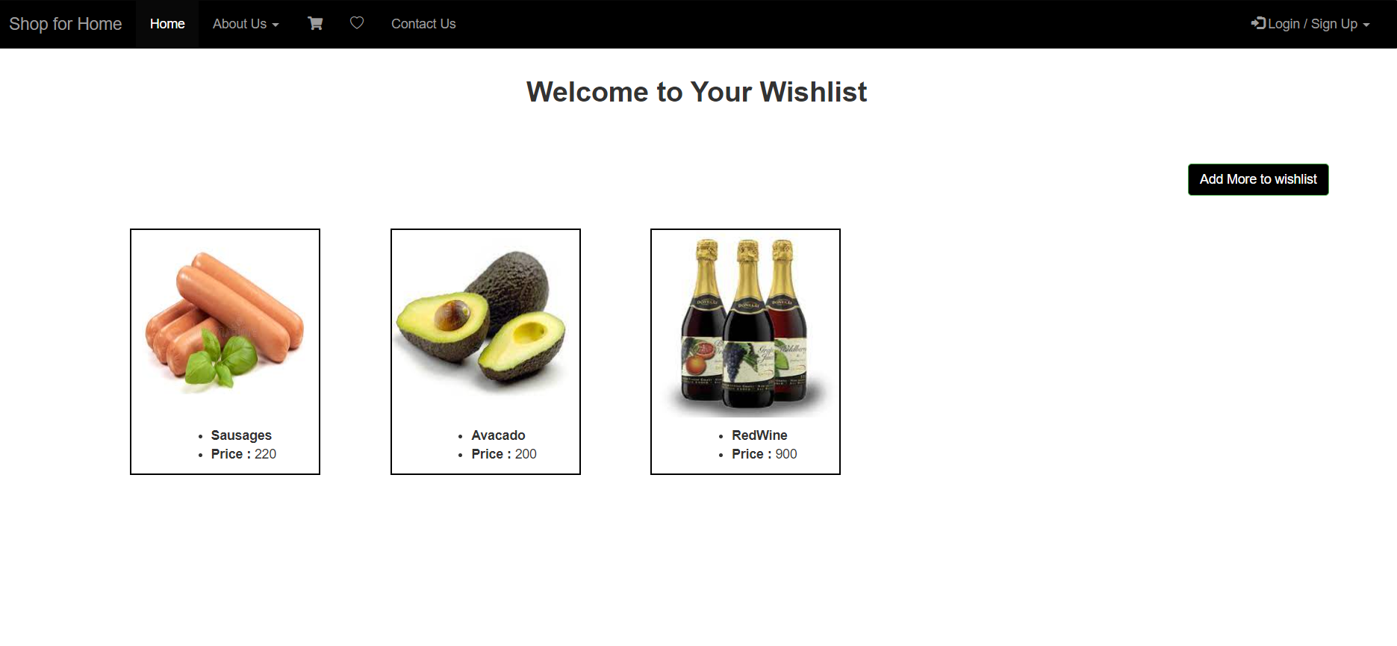
MY WISHLIST

Slide 14
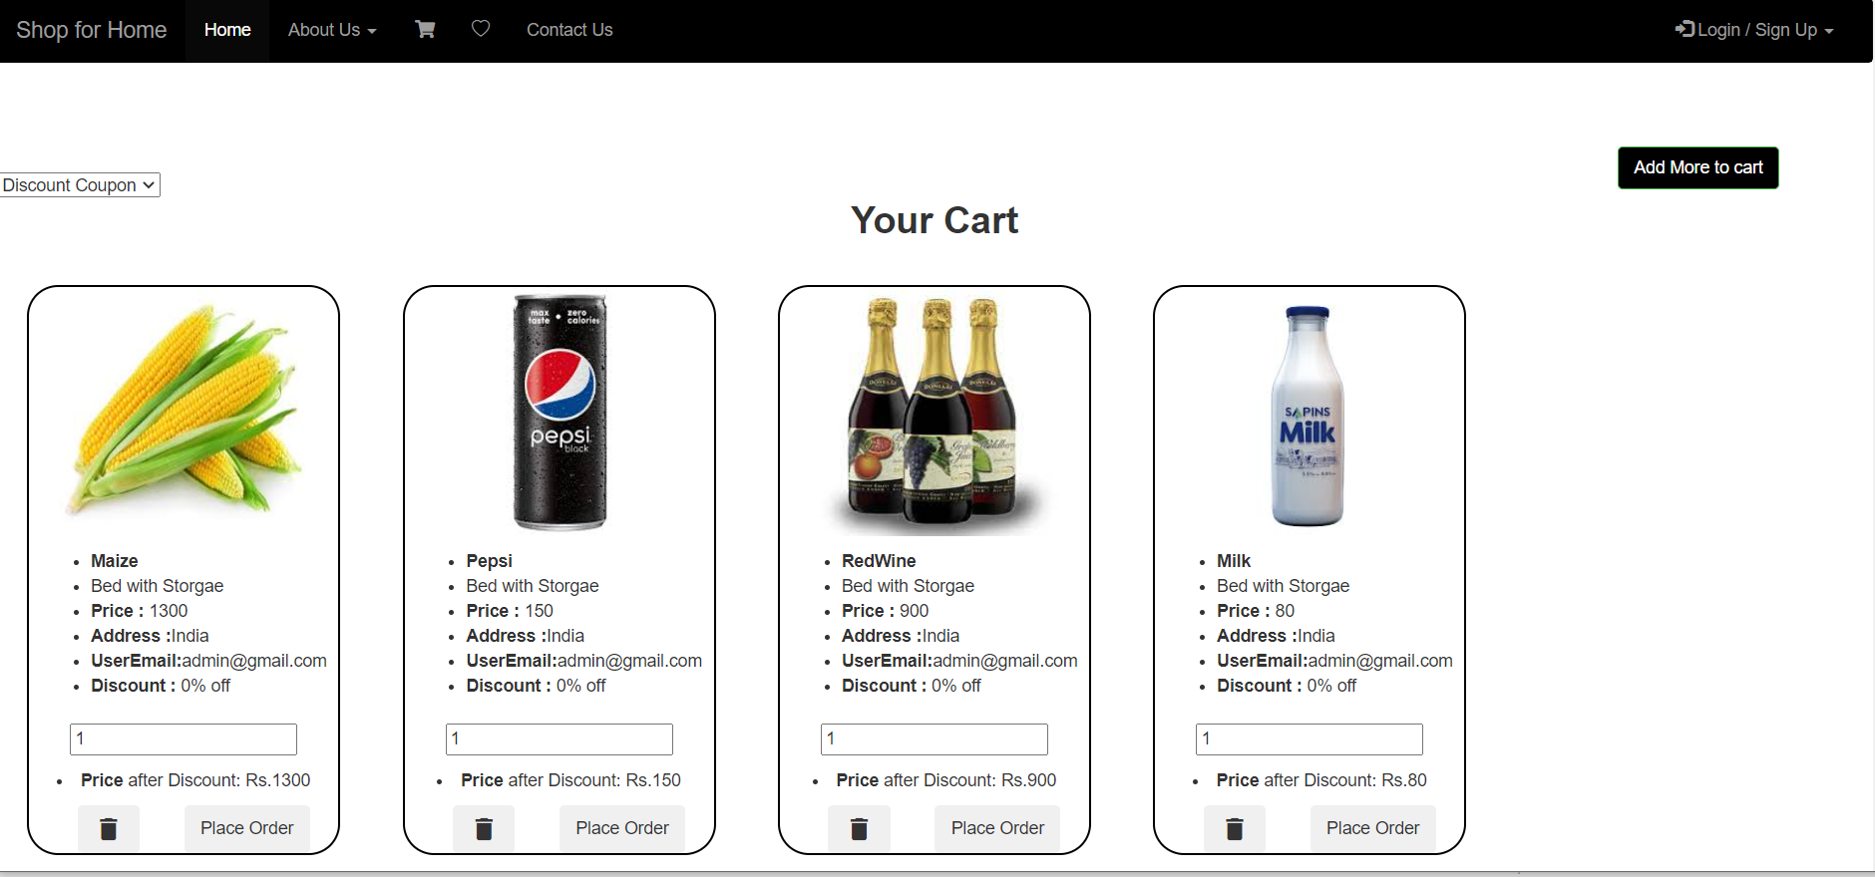
CART ITEMS

Slide 15
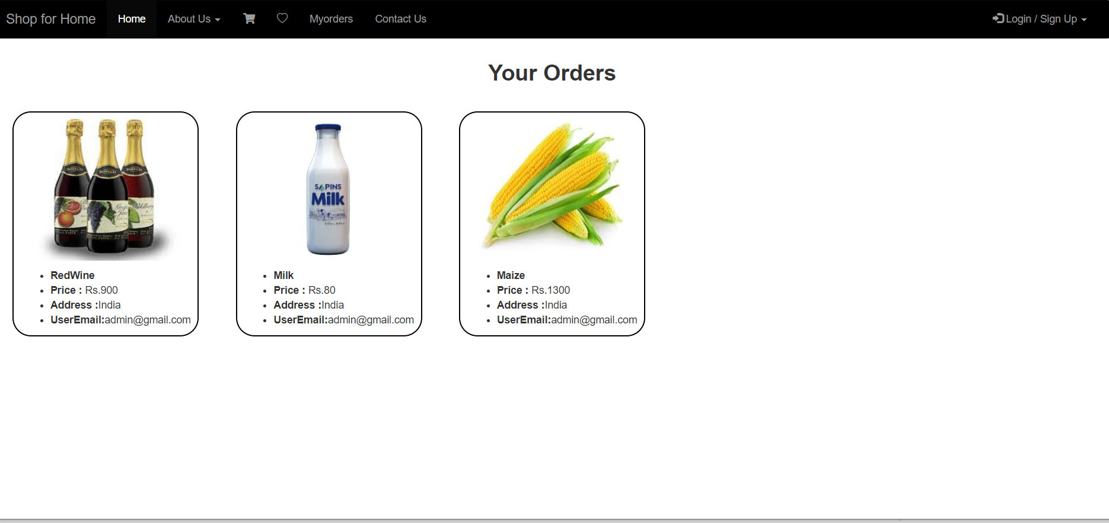
MY ORDERS

Slide 16
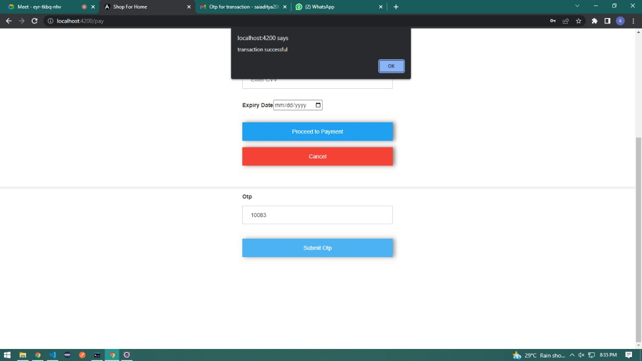
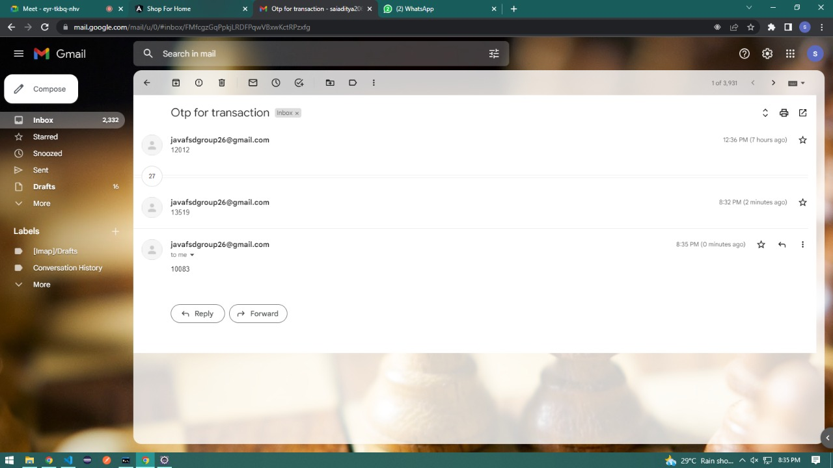
PAYMENT

Slide 17
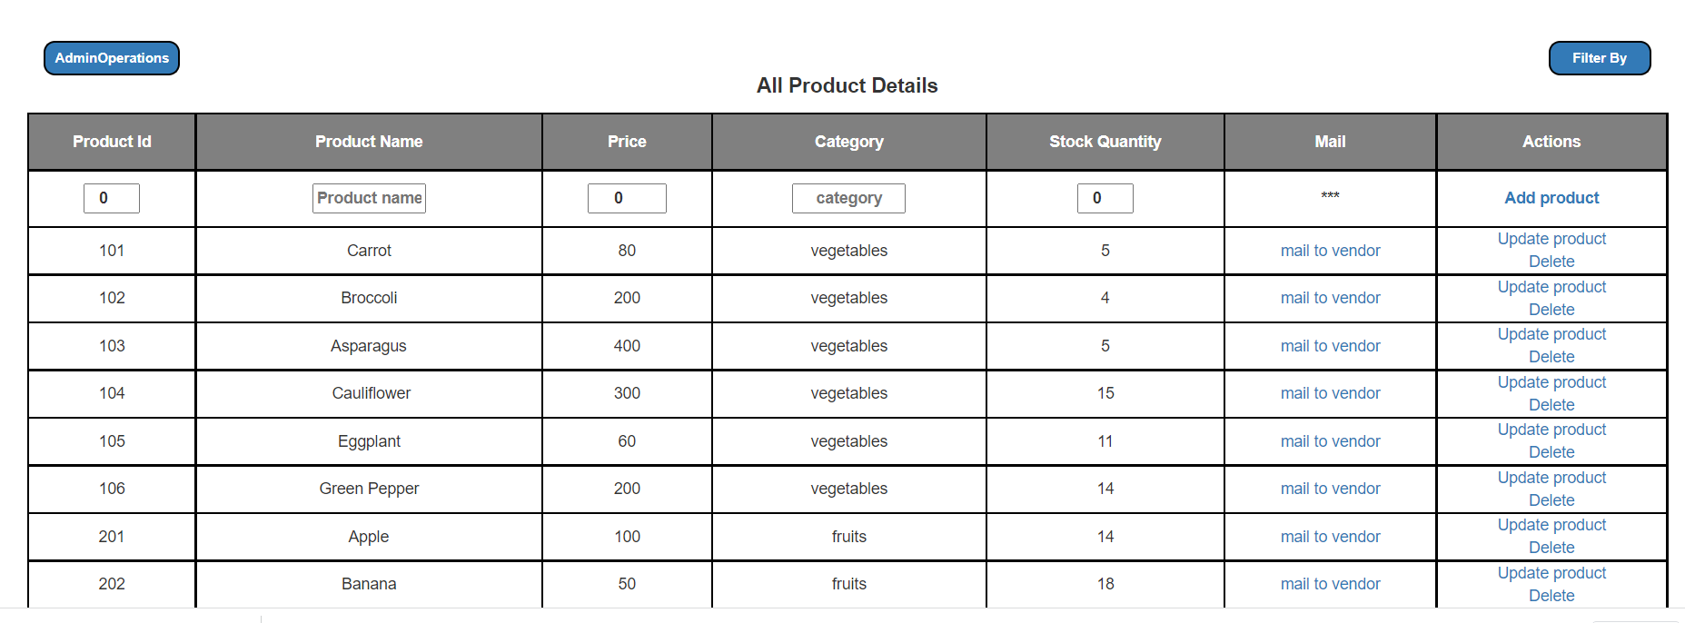
ADMIN- PRODUCT DETAILS

Slide 18
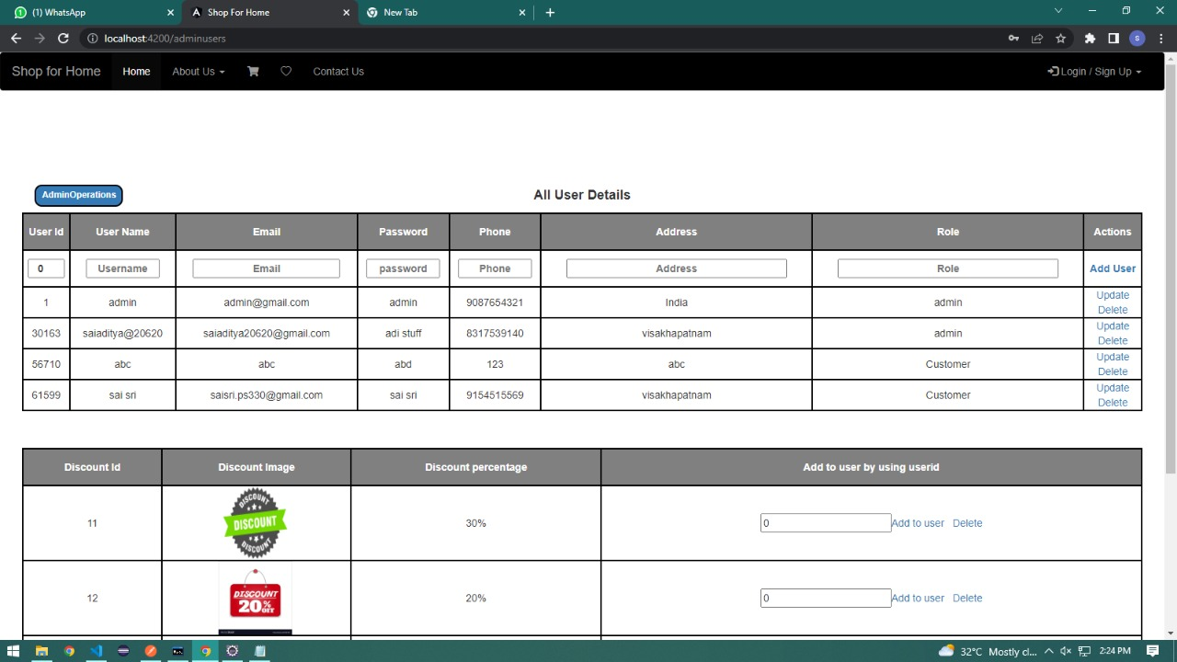
USER DETAILS

Slide 19
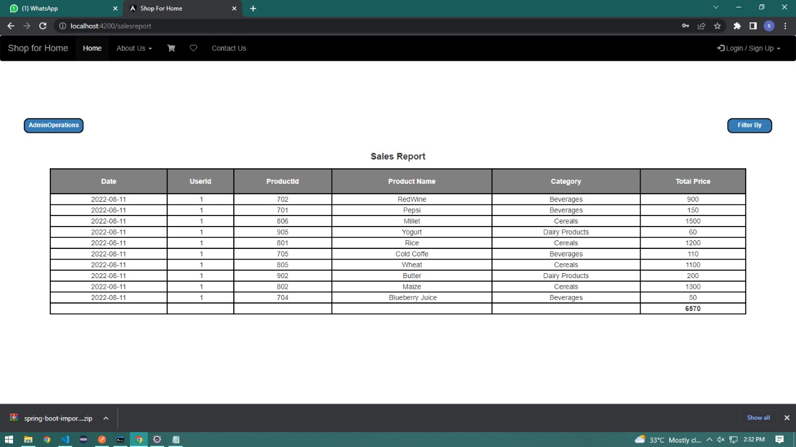
SALES REPORT

Slide 20
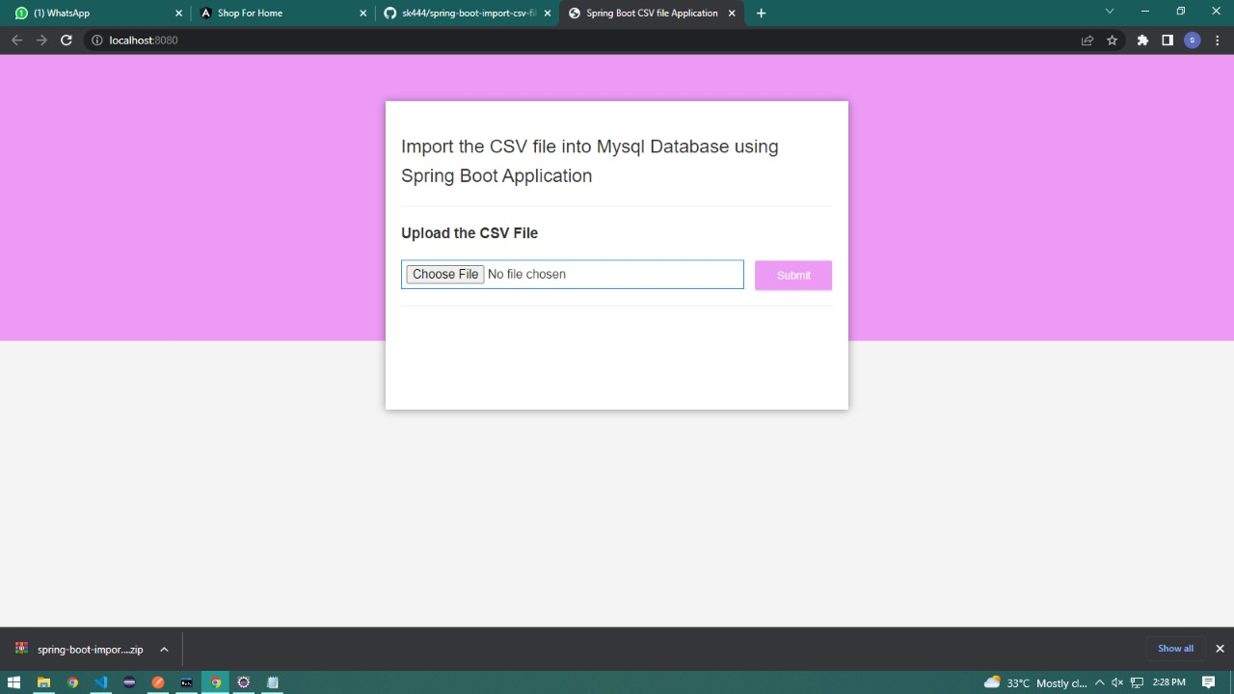
UPLOAD STOCKS

Slide 21
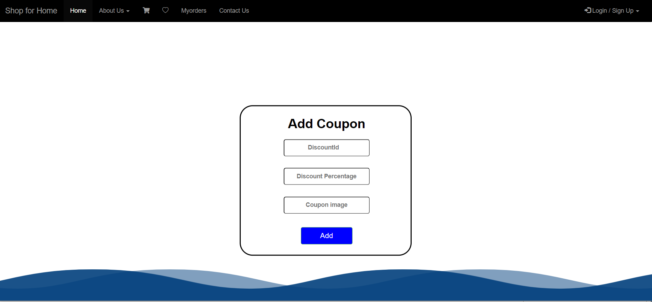
DISCOUNT COUPON

Slide 22
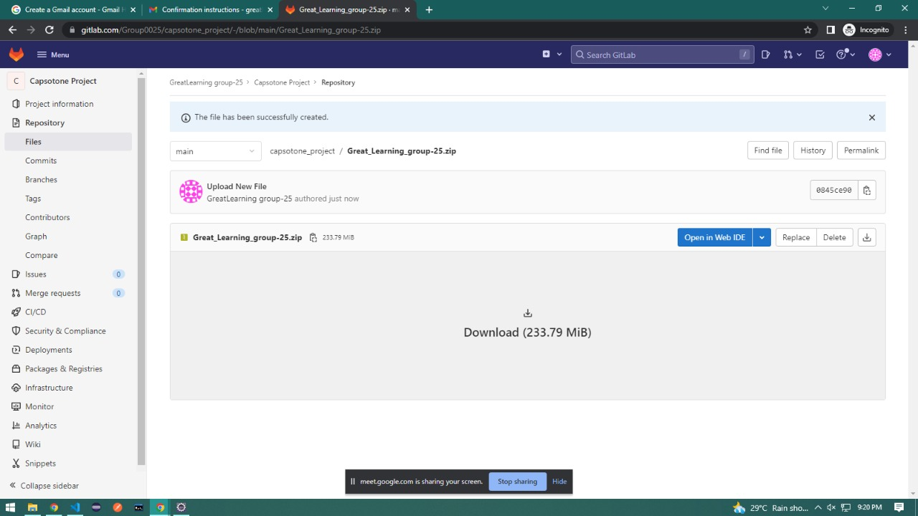
GIT REPOSITORY Link - https://gitlab.com/Group0025/capsotone_project/-/blob/main/Great_Learning_group-25.zip

Slide 23
CONCLUSION
The availability of online shopping has produced a more educated consumer that can shop around with relative ease without having to spend a large amount of time. In exchange, online shopping has opened up doors to many small retailers that would never be in business if they had to incur the high cost of owning a brick and mortar store. At the end, it has been a win-win situation for both consumer and sellers.

Slide 24


